Slide 1
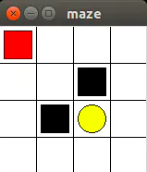
1 2 3 4
5 6 7 8
9 10 11 12
13 14 15 16
-0.69
-0.81
-0.96
-0.74
1
2
3
4
-0.81
-1.13
-1.77
-0.77
5
6
7
-0.96
-1.77
0.38
-0.15
8
9
-0.74
-0.77
-0.15
-0.13
10
11
12
13
1
2
3
4
0
0
0
0
5
6
7
8
0
0
-1
0
9
10
11
12
0
-1
1
0
13
14
15
16
0
0
0
0

